Slide 1

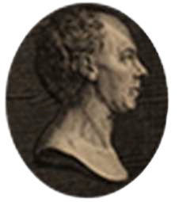
Analytical Methods of Celestial Mechanics
Saint-Petersburg, Russia, 17-21 August 2026
Sundiving solar sails for fast space exploration
Denis Perepukhov
Keldysh Institute of Applied Mathematics, RAS

Slide 2
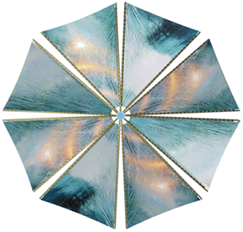
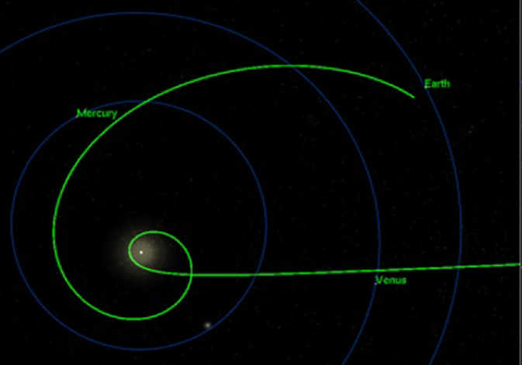
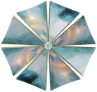

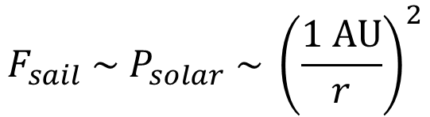
WHAT A SUNDIVER IS
$v_{∞}$ = 10-100 km/s
Solar sail
$$F_{sail} \sim P_{solar} \sim {\left(\frac{1 AU}{r}\right)}^{2}$$
[1]
Voyager I ≈ 17 km/s
  1. Depart from the Earth
  2. “Dive” into the Sun’s vicinity
  3. Fly away along a hyperbola
The Oberth effect
+
High SRP
[1] Turyshev, Slava G., et al. "Science opportunities with solar sailing smallsats." Planetary and Space Science 235 (2023)

Slide 3
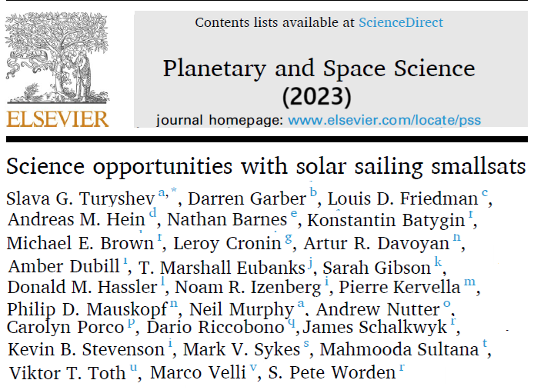
SUNDIVERS APPLICATIONS

Slide 4
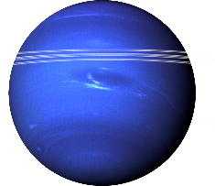
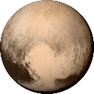
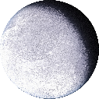
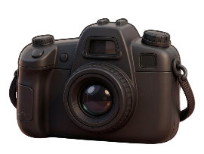

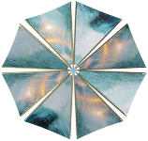
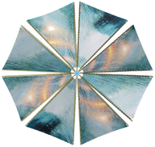

SUNDIVERS APPLICATIONS: FLY-BY MISSIONS TO DISTANT OBJECTS
Neptune
in 3 years
Pluto
in 3-5 years
Eris
in 3.5-10 years
$$v_{∞}=10 AU/year$$
Send several at once!

Slide 5
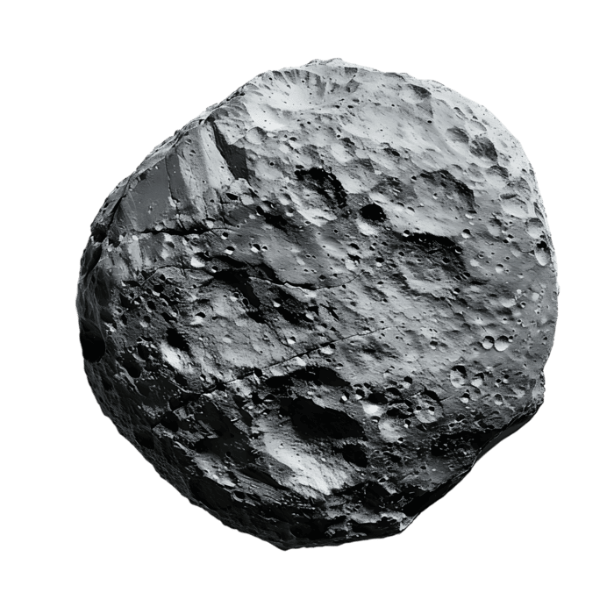
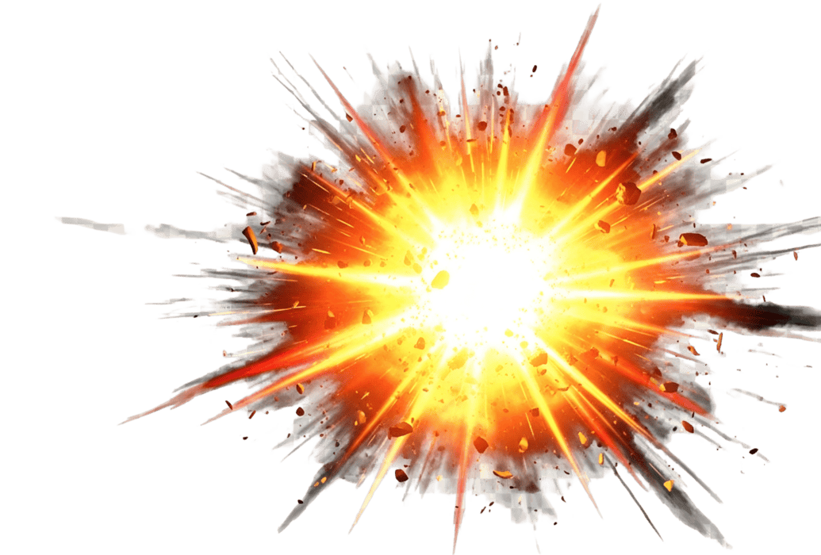

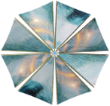
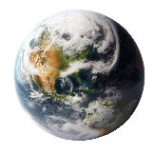
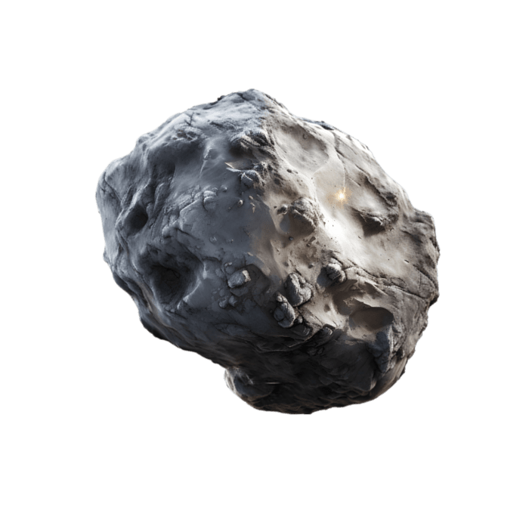
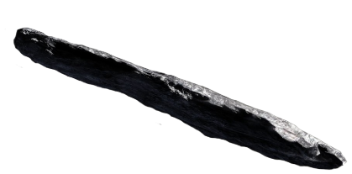

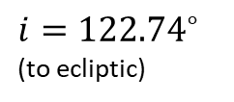
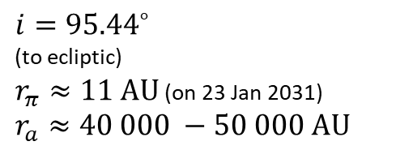


SUNDIVERS APPLICATIONS: ASTEROID STUDIES
Asteroid deflection
'Aylo'chaxnim
Hard-to-reach asteroids
$${15.86}^{∘}$$
(to ecliptic)
Interstellar objects interception & impact-probing
Guests from
the Oort cloud
$$v$$
$$v$$
$${i=95.44}^{∘}$$
(to ecliptic)
$r_{π}≈11 AU$ (on 23 Jan 2031)
$$r_{a}≈40 000 −50 000 AU$$
$$v$$
1I/ʻOumuamua
C/2014 UN₂₇₁ (Bernardinelli–Bernstein)
${i=122.74}^{∘}$
(to ecliptic)
Notes:
'Aylo'chaxnim is completely inside Venus’ orbit

Slide 6


SUNDIVERS APPLICATIONS: HELIOPHYSICS AND BEYOND
Solar polar
imager
10 years
of testing gravity theories
Imaging exoplanets
Solar Gravitational Lens’ Focus
(55+ years)
Heliopause
(~12 years)
Bow shock
(~23 years)
Termination shock
(8-10 years)
$$v_{∞}=10 AU/year$$
Heliosphere & interstellar medium exploration
Notes:
Bow shock may not exist afterall

Slide 7
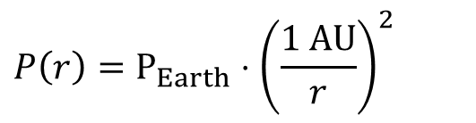
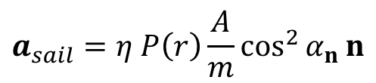
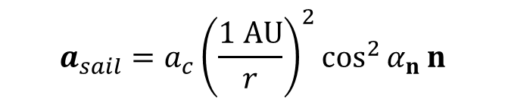
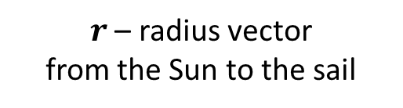
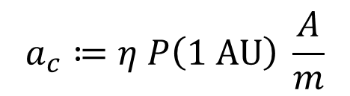
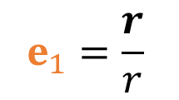


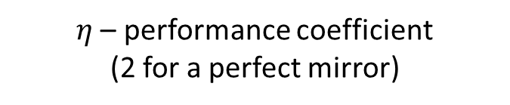
SOLAR SAILING BASICS
Flat solar sail
$$β≔{a_{c}}/{6 \text{mm}\text{/}\text{s}\text{2}}$$
$$a_{sail}=η P\left(r\right)\frac{A}{m}\cos^{2}{α_{n}}n$$
Lightness number
F_{sail}
$η$ – performance coefficient
(2 for a perfect mirror)
n
$$P\left(r\right)=P_{Earth}⋅{\left(\frac{1 AU}{r}\right)}^{2}$$
Reflected light
direction
Control
– solar radiation pressure
$$α_{n}$$
$$e_{1}=\frac{r}{r}$$
A – area of the sail
Incident light
direction
m – mass of the spacecraft
(sail + payload)
n – unit normal vector
of the sail’s backside
Characteristic acceleration (mm/s²)
$$a_{c}≔η P\left(1 AU\right) \frac{A}{m}$$
$r$ – radius vector
from the Sun to the sail
$$a_{sail}=a_{c}{\left(\frac{1 AU}{r}\right)}^{2}\cos^{2}{α_{n}}n$$

Slide 8

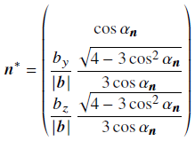
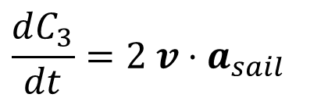

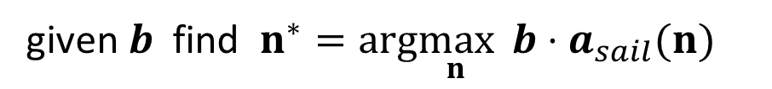
HOW TO CONTROL A SOLAR SAIL
An ubiquitous subproblem:
given $b$ find $n^{∗}=arg\max_{n}{ b⋅a_{sail}(n)}$
A known solution:
Assuming a flat specularly-reflecting sail
$$\frac{dC_{3}}{dt}=2 v⋅a_{sail}$$
Example:
to increase energy, take $n^{∗}=arg\max_{n}{ v⋅a_{sail}(n)}$
“Locally-optimal” control law
The maximum principle leads to the same subproblem:
$$n^{∗}=arg\max_{n}{ b(r, v,p_{r},p_{v})⋅a_{sail}(n)}$$

Slide 9






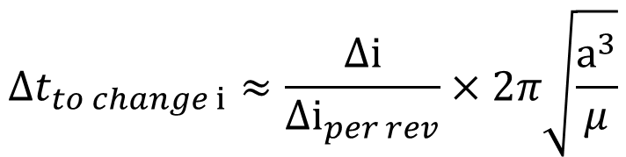
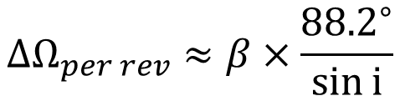

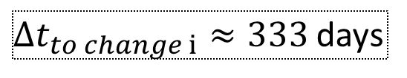
UNCONSTRAINED GEOMETRY
Yes, it’s independent of the orbit’s radius!
$$Δi_{per rev}≈β×{88.2}^{∘}$$
$$Δi$$
$$Δt_{to change i}≈\frac{Δi}{Δi_{per rev}}×2π\sqrt{\frac{a^{3}}{μ}}$$
$$Δi={90}^{∘}$$
$$a=0.2 AU$$
$$β=0.1$$
$Δt_{to change i}≈333$ days
$Δi_{per rev},ΔΩ_{per rev},Δω_{per rev}$ are interconnected
$$ΔΩ_{per rev}≈β×\frac{{88.2}^{∘}}{\sin{i}}$$
$$ΔΩ$$
We can achieve any
orbit orientation we want

Slide 10
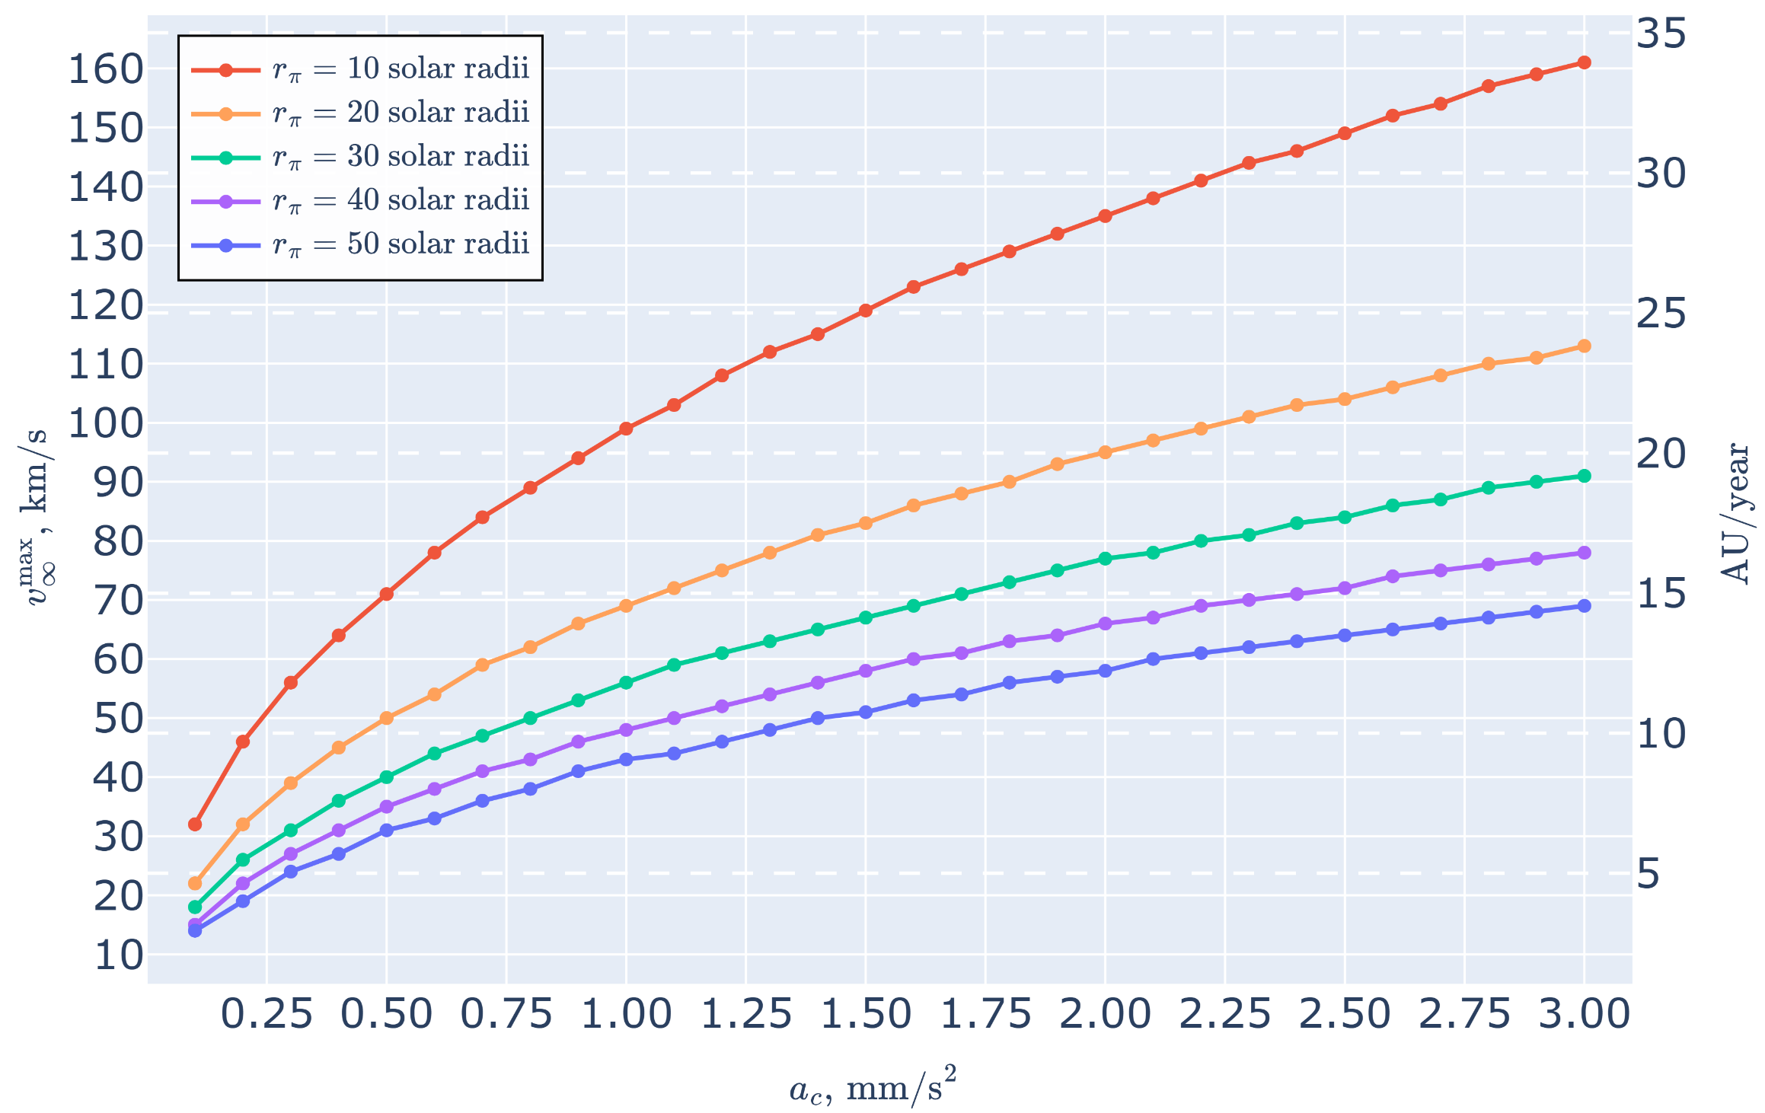
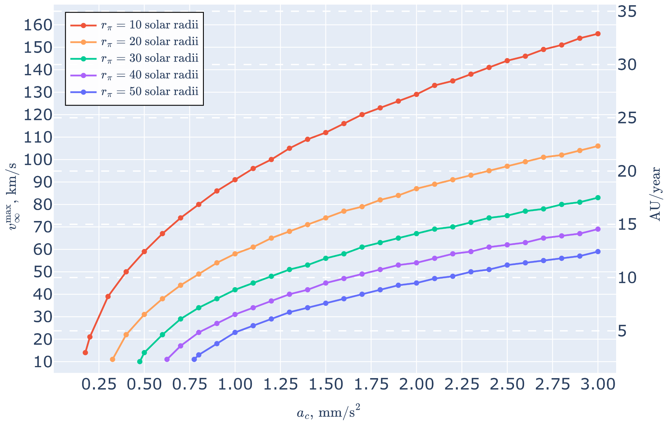
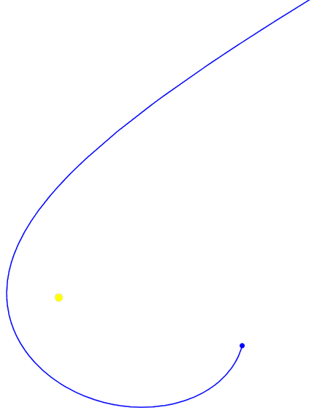

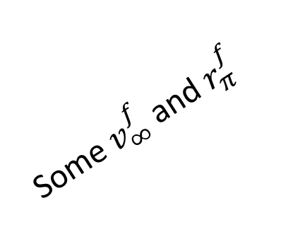
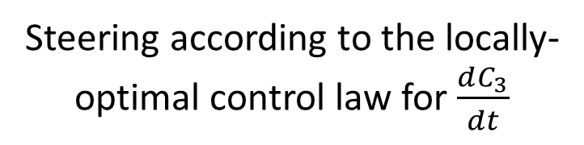
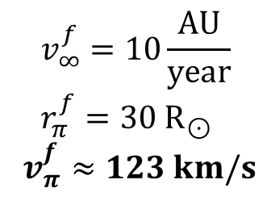
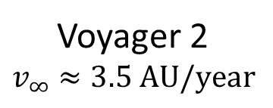
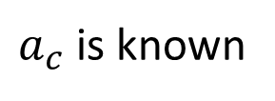



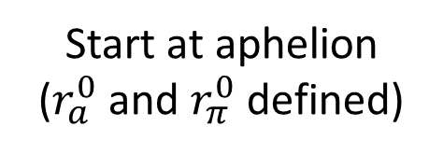
HOW FAST WE CAN GO
$$f$$
$$f$$
Voyager 2
$$v_{∞}≈3.5 AU/year$$
Steering according to the locally-optimal control law for $\frac{dC_{3}}{dt}$
$$r_{a}^{0}≤1 AU$$
$$f$$
$$f$$
$$r_{a}^{0}≤ +∞$$
Some $v_{∞}^{f}$ and $r_{π}^{f}$
$$f$$
$$f$$
$$f$$
$$f$$
$$f$$
$$f$$
$$v_{∞}^{f}=10\frac{AU}{year} \\ r_{π}^{f}=30 R_{⊙}$$
$v_{π}^{f}≈123 km/s$
Start at aphelion
($r_{a}^{0}$ and $r_{π}^{0}$ defined)
The “dive”
Perepukhov D., Diugaeva Iu. Sundivers performance analysis with locally optimal control law // Advances in Space Research, 2026, In Press, 10.1016/j.asr.2026.01.104
$a_{c}$ is known

Slide 11
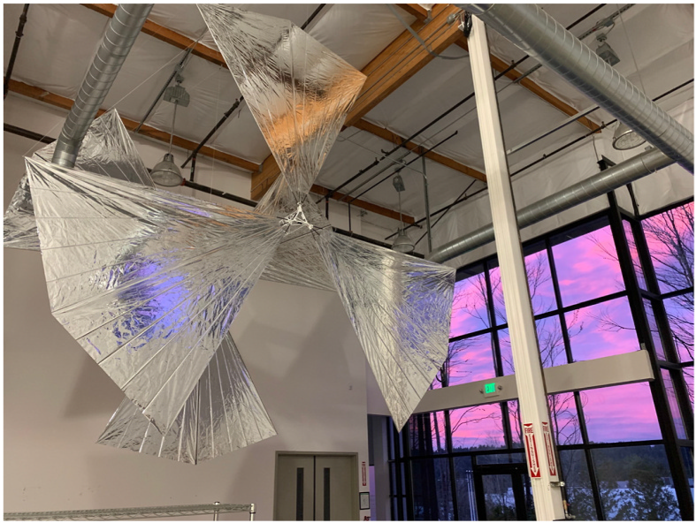
SOLAR SAIL ARCHITECTURE
“Sunvane” architecture
6 articulated vanes
5-m long truss with payload
5-μm aluminized Kapton sails
Areal density
of sail material ≈ 3.55 g/m²
Linear density (total)
of support structure
≈ 110.87 g/m
A scale model built at L’Garde, USA
shown at the Xplore facility in March 2023 [1].
[1] Turyshev, Slava G., et al. "Science opportunities with solar sailing smallsats.“
Planetary and Space Science 235 (2023)

Slide 12
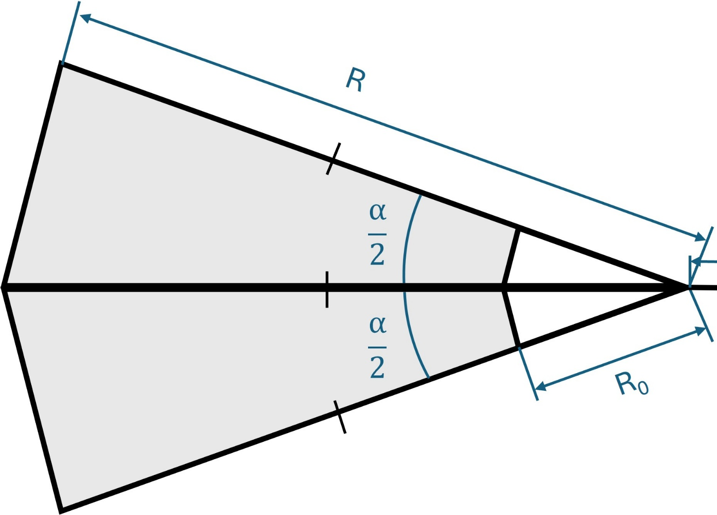
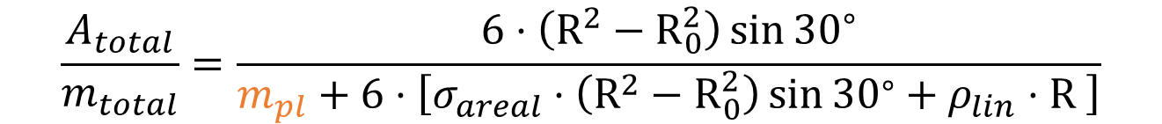




SOLAR SAIL ARCHITECTURE
$$\frac{A_{total}}{m_{total}}=\frac{6⋅\left(R^{2}−R_{0}^{2}\right)\sin{{30}^{∘}}}{m_{pl}+6⋅\left[σ_{areal}⋅\left(R^{2}−R_{0}^{2}\right)\sin{{30}^{∘}}+ρ_{lin}⋅R \right]}$$
$$α={60}^{∘}$$
Scales linearly
$$R_{0}=0.5 m$$
$$ρ_{lin} \text{≈ 110.87 }\text{g}\text{/}\text{m}$$
$$σ_{areal} \text{≈ }\text{3.55 }{\text{g}\text{/}\text{m}}^{2}$$
Cutting-edge
materials
$$m_{1 vane}=σ_{areal}⋅\left(R^{2}−R_{0}^{2}\right)\sin{{30}^{∘}}+ρ_{lin}⋅R$$
Scales quadratically

Slide 13
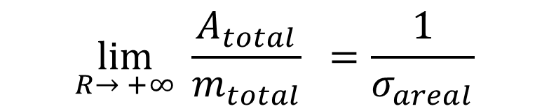
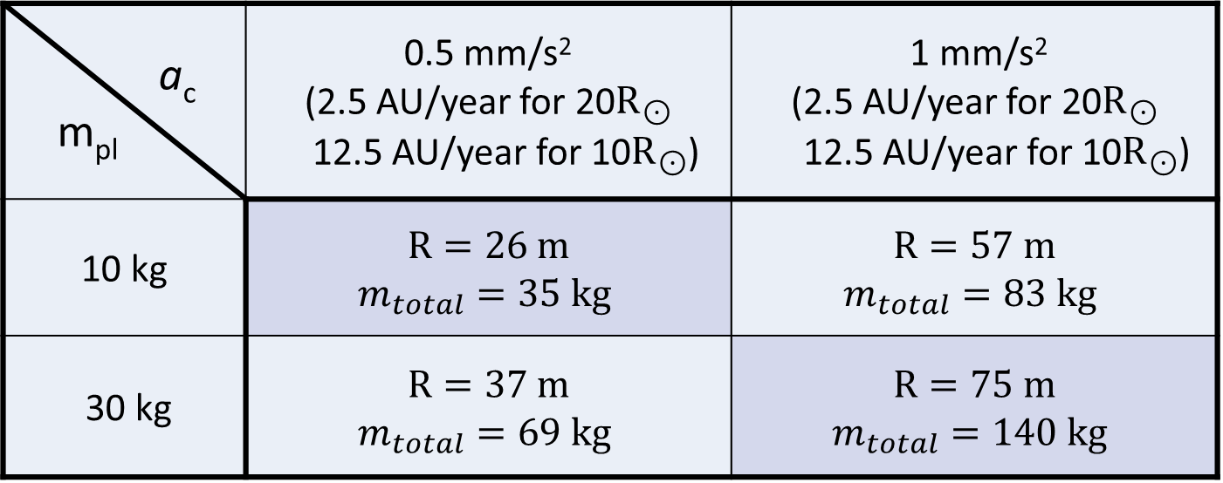
SOLAR SAIL SIZES
a_{c} m_{pl} | 0.5 mm/s² (2.5 AU/year for 20$R_{⊙}$ 12.5 AU/year for 10$R_{⊙}$) | 1 mm/s² (2.5 AU/year for 20$R_{⊙}$ 12.5 AU/year for 10$R_{⊙}$)
10 kg | $$R=26 m$$ $m_{total}=35 kg$ | $$R=57 m$$ $m_{total}=83 kg$
30 kg | $$R=37 m$$ $m_{total}=69 kg$ | $$R=75 m$$ $m_{total}=140 kg$
We can’t increase size forever!
$$\lim_{R→ +∞}{ \frac{A_{total}}{m_{total}} }=\frac{1}{σ_{areal}}$$

Slide 14
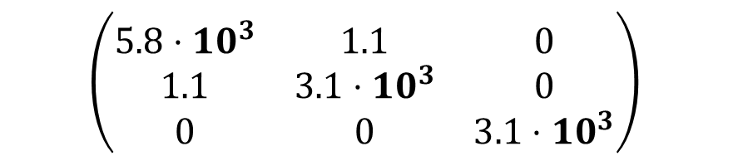
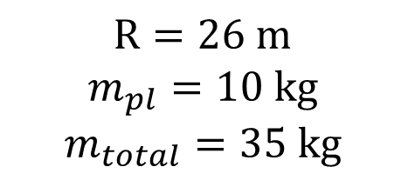

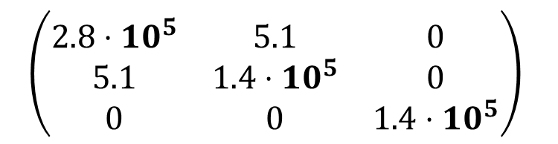

SOLAR SAIL MASS DISTRIBUTION
y
O
x
$$R=26 m$$
$$m_{pl}=10 kg$$
$$m_{total}=35 kg$$
$$R=75 m$$
$$m_{pl}=30 kg$$
$$m_{total}=140 kg$$
$$\left(\begin{matrix}5.8⋅{10}^{3} & 1.1 & 0 \\ 1.1 & 3.1⋅{10}^{3} & 0 \\ 0 & 0 & 3.1⋅{10}^{3}\end{matrix}\right)$$
$$\left(\begin{matrix}2.8⋅{10}^{5} & 5.1 & 0 \\ 5.1 & 1.4⋅{10}^{5} & 0 \\ 0 & 0 & 1.4⋅{10}^{5}\end{matrix}\right)$$
Inertia tensor
$$kg⋅m^{2}$$

Slide 15












SOLAR SAIL TORQUES
$$R=26 m m_{pl}=10 kg{ m}_{total}=35 kg$$
One sail relative its attachment point
$$r=1 AU$$
$${|F}_{x}|=0.003 N$$
$${|M}_{z}|=0.031 N⋅m$$
Sails are balanced
$$r=20{ R}_{⊙}$$
Six sails, one misaligned on $1^{∘}$
$${|F}_{x}|=0.332 N$$
$${|M}_{z}| = 3.54 N⋅m$$
$$1^{∘}$$
$$r=20{ R}_{⊙}$$
$${|δF}_{y}|=0.006 N$$
$${|δM}_{z}|=0.015 N⋅m$$
Typical flywheel gives:
$∼0.001 N⋅m$ on a smallsat
$∼0. 1 N⋅m$ on a bigsat

Slide 16




SOLAR SAIL TORQUES
Angular motion
for a sample trajectory
Disturbance torques can be greater
than required control torques
Both control and parasite torques
can hardly be compensated with flywheels
Angular motion will be controlled
mostly by trimming the sails
Flywheels will only be used for minor corrections
During the closest approach to the Sun:
$R=26 m$
$r=20{ R}_{⊙}$
Required control torque
Offset parasite torque
$$\max_{t}{ J×ε}≈0.016 N⋅m$$
$${|δM}_{z}|≈0.015 N⋅m$$

Slide 17

CONCLUSIONS
Sundiving solar sails offer great scientific opportunities:
  Planetary studies
  Asteroid studies
  Heliophysics
  Interstellar medium exploration
Diving to 50 solar radii allows to achieve 5 AU/year with $a_{c}=1\frac{mm}{s^{2}}$
to 20 solar radii allows to achieve 12.5 AU/year
to 10 solar radii allows to achieve 19 AU/year
Solar sails will have to be large: 26-75+ m in radius
Large sails mean large inertia tensor
Disturbances will be substantial
Angular control will have to be done with sails,
flywheels will not suffice in the solar vicinity

Slide 18
THE END
Thank you for your attention!

Slide 19


ENERGY FLOWS
At $r=20{ R}_{⊙}$ energy income is $W≈158 000 Wt/m^{2}$
With front reflection of 0.9 and back emissivity of 0.25
it gives about ${752}^{ ∘}C$
At $r=50{ R}_{⊙}$ energy income is $W≈25 280 Wt/m^{2}$
With front reflection of 0.9 and back emissivity of 0.25
it gives about ${376}^{ ∘}C$

